Slide 1
Leaf Health Diagnosis using DEEP Learning (CNN)

Slide 2

Problem Statement
Overview of the issue:
Detecting and treating plant diseases with the correct treatment is crucial for crop health.
The immense variety in plant diseases, makes it challenging to accurately identify the specific disease affecting the plant.
This variability delays the appropriate treatment methods, thereby impacting crop yield and quality.
Addressing this complexity in disease identification is essential to ensure timely and targeted interventions for maintaining the health and productivity of crops.

Slide 3
Objective :
Aim: To develop an end-to-end system for leaf disease identification and treatment recommendation.
Key objectives: User-friendly interface, accurate disease classification, treatment suggestions.

Slide 4
Project Architecture
Data Selection
Model Deployment
Data Preparation
Model Building
Model Evaluation
Save Best Model
Data Preprocessing

Slide 5
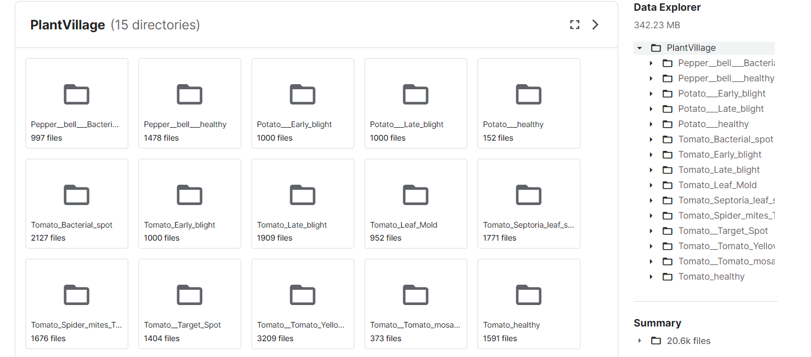
Dataset Credits:
Download Dataset named PlantVillage from: https://www.kaggle.com/arjuntejaswi/plant-village
The PlantVillage Folder has 20,638 images of Leaves in their respective category folder.

Slide 6
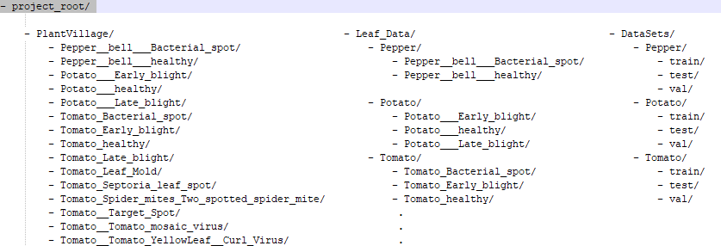
Data Description and Preparations
We have three plant categories Pepper, Potato and Tomato. We Segregate all the folders into their respective Plant Category folder by moving them in ‘Leaf_Data’ directory.
Then renaming the ‘PlantVillage’ Directory to ‘DataSets’ we use splitfolders package from Python to create train, test, validation data in the ratio (0.7, 0.15, 0.15) for each Plant Category.

Slide 7
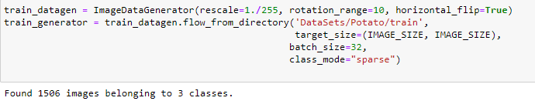
Data Preprocessing
We use ImageDataGenerator package from keras for data augmentation:
ImageDataGenerator sets up rules for how the augmentation should be applied to the images.
flow_from_directory function reads images from the specified director ('DataSets/Pepper/train') and generates batches of augmented images.
The augmentation happens dynamically, meaning : Without altering the training dataset the generator will create new variations of these images on-the-fly for each EPOCH based on the defined augmentation parameters.

Slide 8
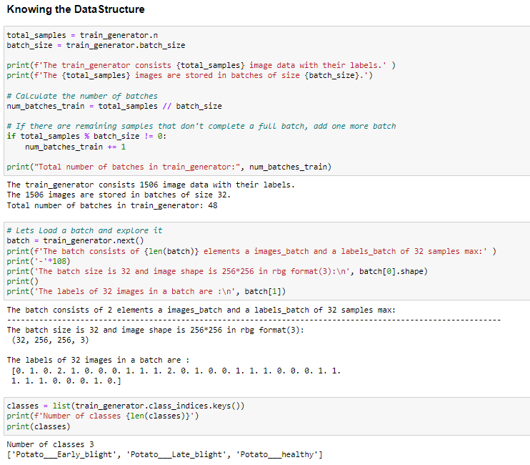
Know How the Data is Stored in Batches :

Slide 9
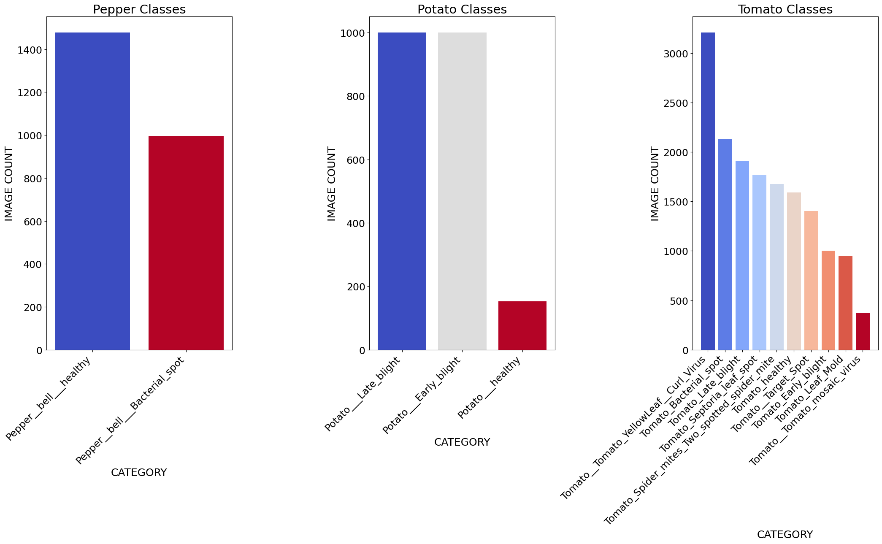
Data Distribution:
We will calculate class weights for Imbalanced Dataset

Slide 10
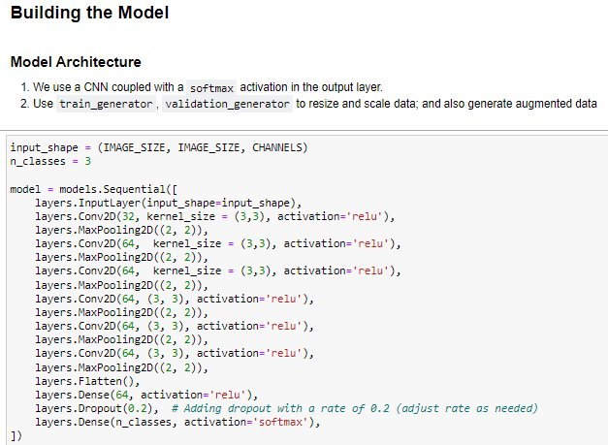
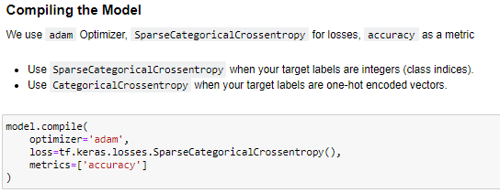
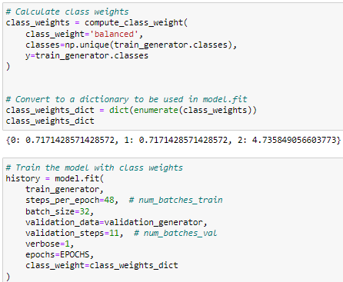
Model Architecture
We utilize CNN architecture with Multiple Convolutional and Pooling layers. Model selection involves trial and error to find the best architecture.

Slide 11
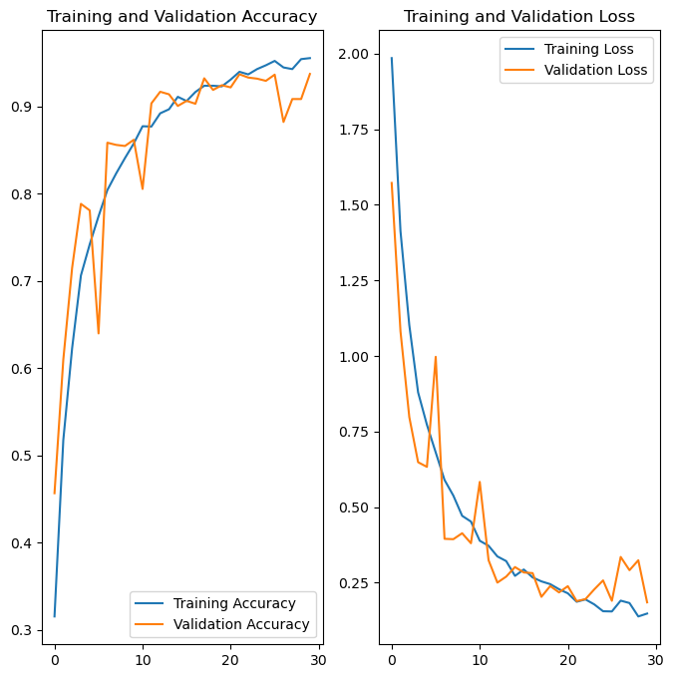
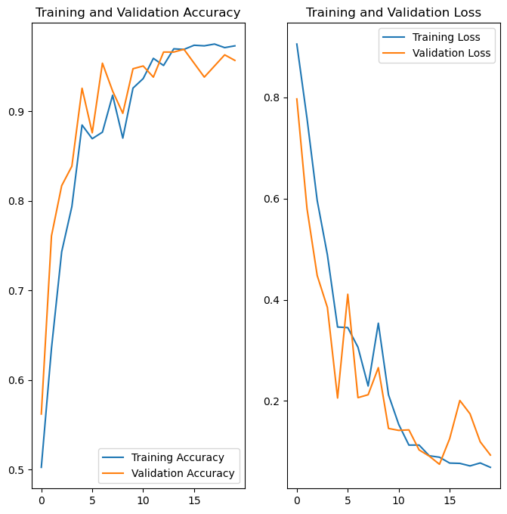
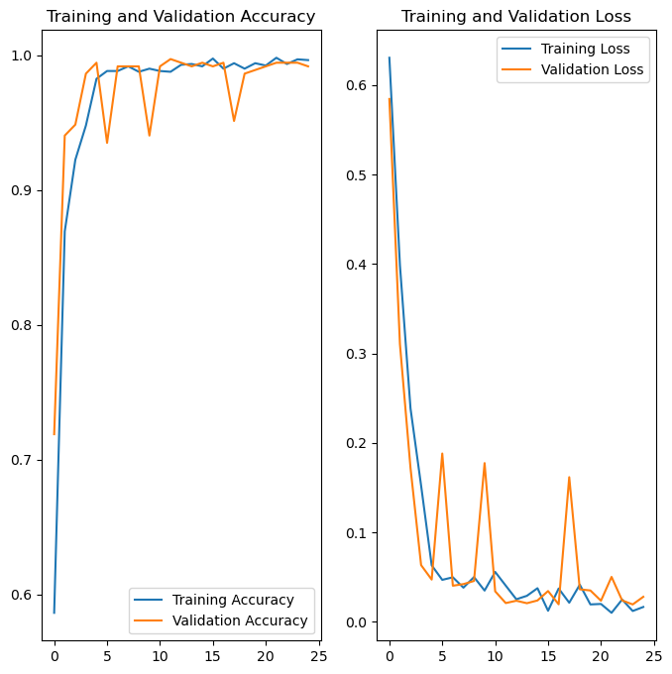
Model Results
Checking Training epochs VS Accuracy and Training epochs VS Loss for Train and Validation datasets to choose the model convergence for the best epochs.
Tomato Model
Potato Model
Pepper Model

Slide 12
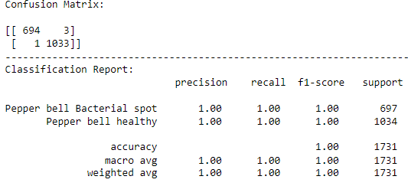
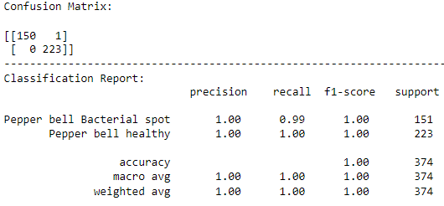
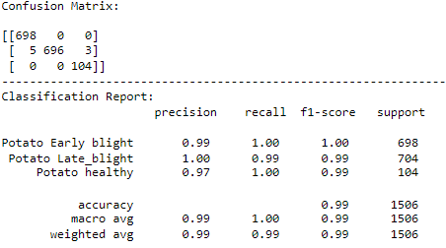
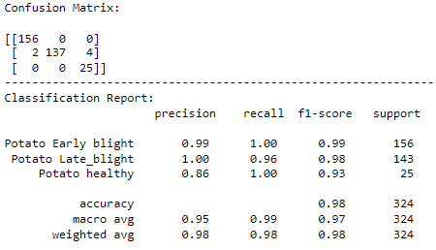
Model Evaluation on Train and Test Data
On Train Data
On Test Data
Pepper Model
Potato Model

Slide 13
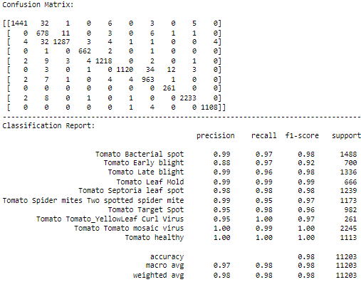
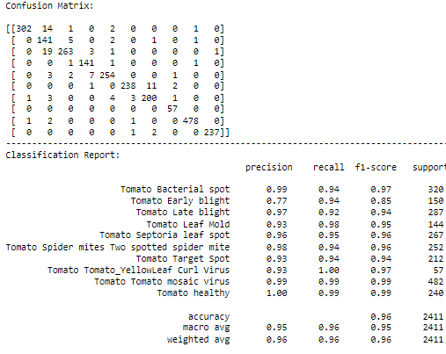
Model Evaluation on Train and Test Data
On Train Data
On Test Data
Tomato Model

Slide 14
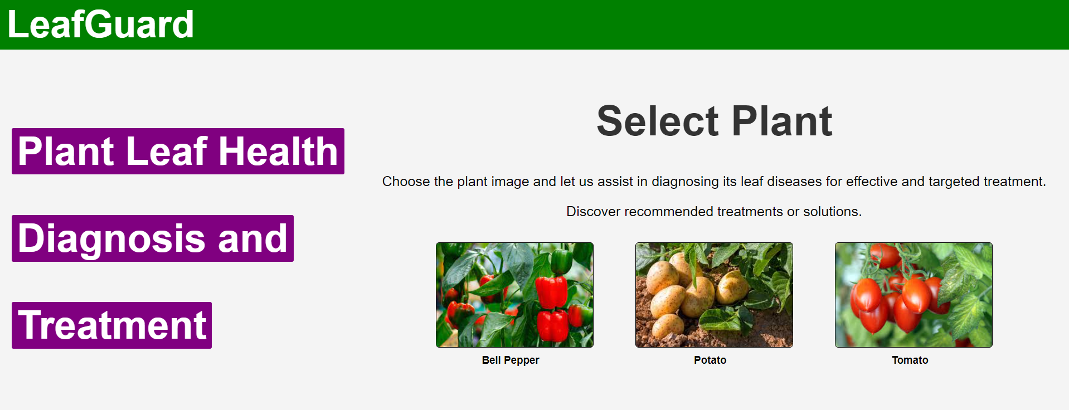
Model Deployment
Model deployment using FAST API app. Creating a UI for users to upload images.

Slide 15
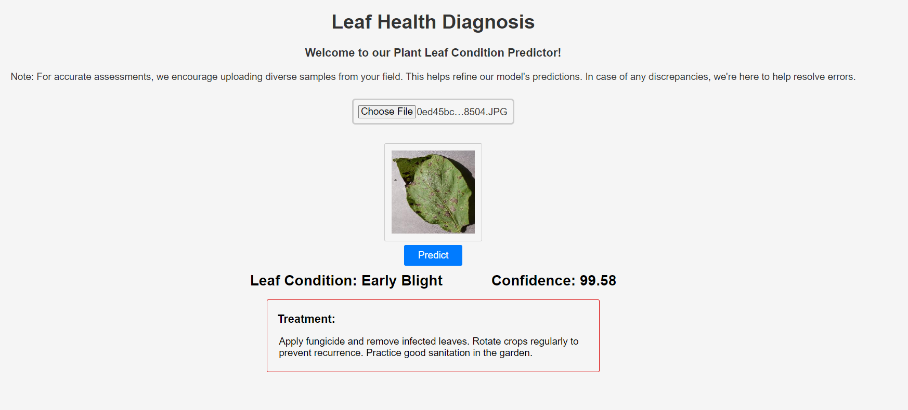

Slide 16
Future Scope
Exploring Alternative Models
Scaling the Plant Diversity
Advancing Towards Production-Level Deployment
Continuous Data Collection and Maintenance
Collaborations with Research Institutions

Slide 17
Conclusion
This solution aims to solve the problem of quick and accurate diagnosis of plant diseases, providing modern-age farmers with technology-driven solutions for better crop health.

Slide 18
References
References for the project.
ImageDataGenerator api to load all images in tensorflow dataset: https://www.tensorflow.org/api_docs/python/tf/keras/preprocessing/image/ImageDataGenerator
Data Set credits: https://www.kaggle.com/arjuntejaswi/plant-village

